Slide 1

Experiences in Using a MOOC to Support Teacher Professional Development of a New AP Course in Computer Science
26th SITE 2015 Conference
Las Vegas, March 2-6, 2015
Dr. Jeff Gray
Professor
Dr. Mokter Hossain
Doctoral Researcher
Department of Computer Science
University of Alabama
Tuscaloosa-35401

Slide 2

Experiences in Using a MOOC to Support Teacher Professional Development of a New AP Course in Computer Science
Outline of the Presentation
Introduction
MOOC and its Popularity
Google’s Course Builder and App Engine
Background of the Study
Procedure
Research Questions
Findings and Discussion
Suggestions for MOOC Developers
Implications of the Study
Conclusions
Acknowledgement

Slide 3
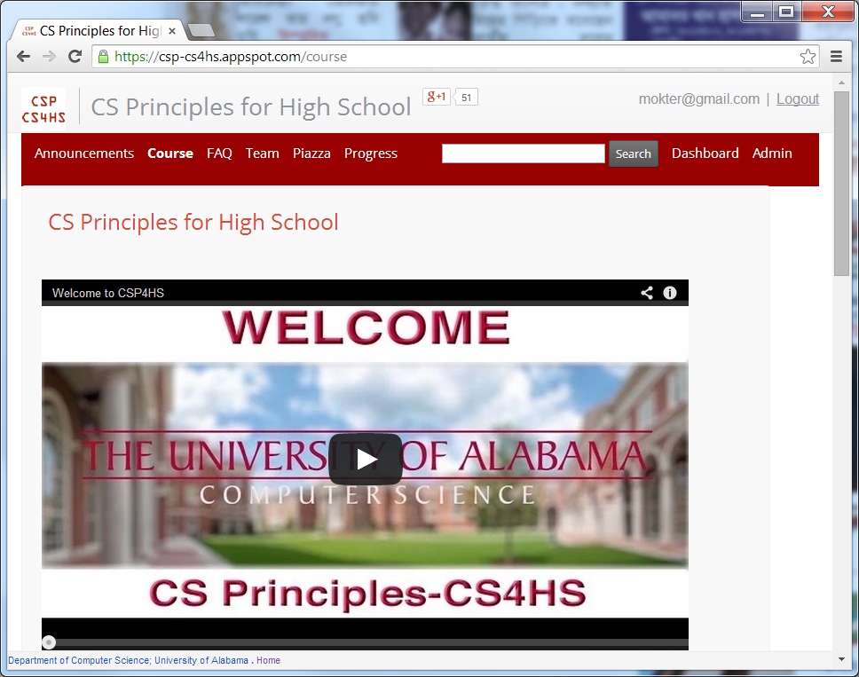
Experiences in Using a MOOC to Support Teacher Professional Development of a New AP Course in Computer Science
Introduction/Abstract
https://csp-cs4hs.appspot.com

Slide 4
Experiences in Using a MOOC to Support Teacher Professional Development of a New AP Course in Computer Science
MOOC and its Popularity
MOOC- A Massive Open Online Course- is an online course that aims to deliver educational services to a large number of participants, often with free, open, and unlimited access. e.g., Coursera, Udacity, edX, etc.
The year 2012 became “the year of the MOOC”, according to The New York Times
26.5% of US universities; 16.5% of Indian universities; 16.2% of Chinese universities; 3.9% of Canadian, Australian, and UK universities provide MOOCs.

Slide 5
Experiences in Using a MOOC to Support Teacher Professional Development of a New AP Course in Computer Science
Google’s Course Builder and App Engine
Google Course Builder (GCB) is an online course management tool. Google inaugurated it in July 2012.
GCB is an open source online platform that deploys course materials on Google App Engine (GAE).
The App Engine is a cloud computing platform that provides services for developing and hosting web applications in Google-managed data centers.
GAE App Engine offers automatic scaling for web applications.

Slide 6
Experiences in Using a MOOC to Support Teacher Professional Development of a New AP Course in Computer Science
Background of the Study
The professional development MOOC is an example of using Course Builder for the design and delivery of a MOOC.
It was offered for high school teachers interested in offering the new College Board Computer Science Principles (CSP) course in their classrooms.
Due to several requests by some participants, the duration of our MOOC was extended through mid-Fall.
The MOOC is still open for participation and available at: https://csp-cs4hs.appspot.com

Slide 7
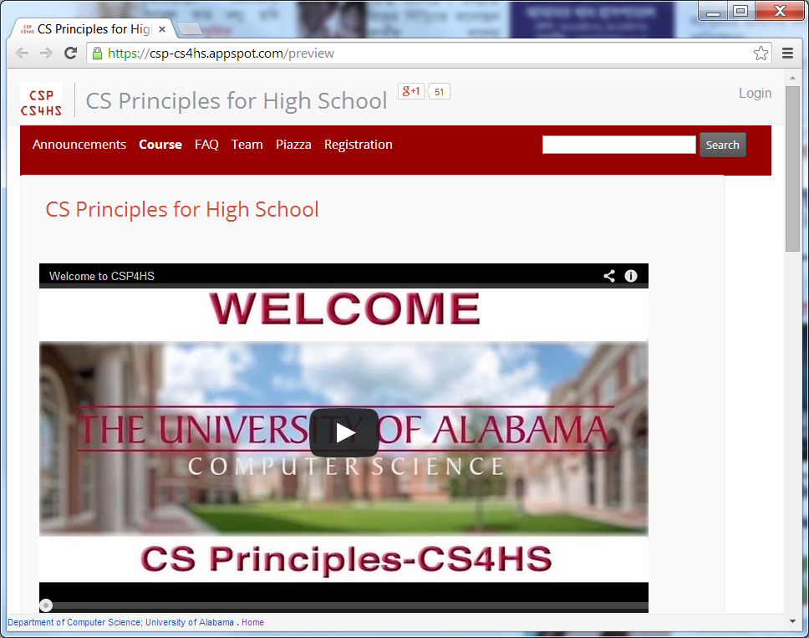
Experiences in Using a MOOC to Support Teacher Professional Development of a New AP Course in Computer Science
Preview Mode
https://csp-cs4hs.appspot.com/preview

Slide 8
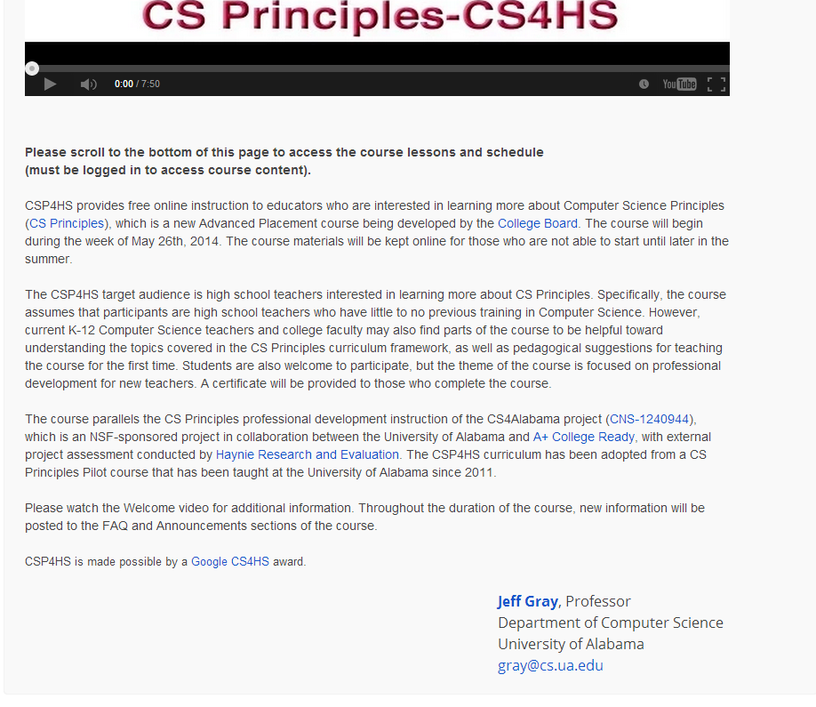
Experiences in Using a MOOC to Support Teacher Professional Development of a New AP Course in Computer Science
Middle of the Home Page
https://csp-cs4hs.appspot.com

Slide 9
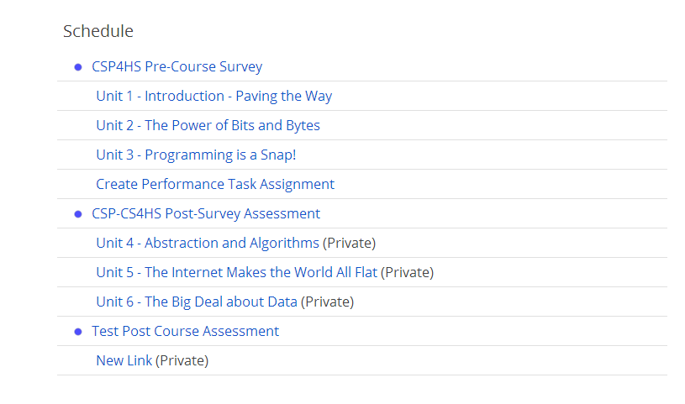
Experiences in Using a MOOC to Support Teacher Professional Development of a New AP Course in Computer Science
Bottom of the Home Page
https://csp-cs4hs.appspot.com

Slide 10
Experiences in Using a MOOC to Support Teacher Professional Development of a New AP Course in Computer Science
Procedure
The aim of this study was to design and deliver a MOOC using Course Builder that focused on CSP course.
Before implementing the real course, we deployed a test course to experiment and configure the desired features that we wanted to provide.
Permission was sought from our university Institutional Review Board (IRB) for conducting pre- and post-surveys with the participants
Both quantitative and qualitative data were retrieved and analyzed for reporting our experience and findings

Slide 11
Experiences in Using a MOOC to Support Teacher Professional Development of a New AP Course in Computer Science
Research Questions
Research question 1: What are the advantages of using Course Builder in designing and implementing a MOOC over a traditional online course management system?
Research question 2: Are there any requirements or open challenges for joining and completing an open online course using Course Builder?
Research question 3: What are the requirements for teachers and researchers in designing and implementing a MOOC on Course Builder?
Research question 4: What are the main challenges in designing and administrating a MOOC and what strategies exist for handling these challenges?

Slide 12
Experiences in Using a MOOC to Support Teacher Professional Development of a New AP Course in Computer Science
Findings and Discussion
Participants’ Information
  There are over 1,150+ participants enrolled in our CS Principles MOOC.
  Participants’ Demographic information were collected an optional anonymous Pre-survey. 583 participants completed the Pre-survey.
  These were form 46 US states and from some other countries including, Australia, Bangladesh, Canada, China, India, Spain, France, Germany, Nigeria, Paraguay, Singapore, and South Korea.
  About 73% were public high school teachers, 20% were private school teachers.
Table – 1. Participants’ teaching level by school type cross tabulation
School Type → ----------------------------------- Teaching Level ↓ |  | Public School | Private School | Charter School | After school program | null | Total
Elementary | 0 | 4 | 3 | 0 | 1 | 0 | 8 (1.4%)
Middle School | 0 | 33 | 18 | 0 | 3 | 2 | 56 (9.5%)
High School | 0 | 341 | 77 | 12 | 0 | 3 | 433 (73.6%)
Post-Secondary | 1 | 29 | 9 | 1 | 0 | 0 | 40 (6.8%)
Currently not Teaching | 0 | 19 | 6 | 1 | 4 | 11 | 41 (7%)
Null | 0 | 4 | 2 | 0 | 0 | 4 | 10 (1.7%)
Total | 1 | 430 (73.1%) | 115 (19.6%) | 14 (2.4%) | 8 (1.4%) | 20 (3.4%) | 588

Slide 13
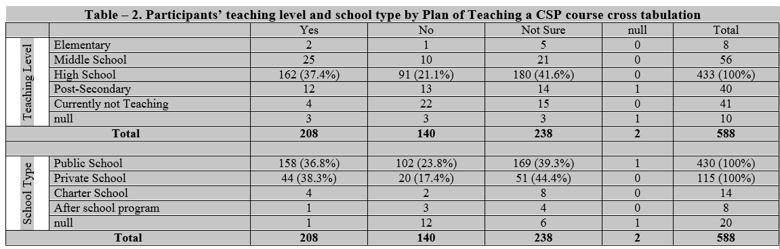
Experiences in Using a MOOC to Support Teacher Professional Development of a New AP Course in Computer Science
Findings and Discussion…
Participants’ Information…
  Among the high school teachers more than 37.4% were currently teaching a CSP course. Moreover, about 41.6% were not sure but might be teaching a CSP course in the near future.
  Among the public and private school teachers, these rates were about 36.8% and 39.3%; and 38.3% and 44.4%, respectively.

Slide 14
Experiences in Using a MOOC to Support Teacher Professional Development of a New AP Course in Computer Science
Findings and Discussion…
In the course schedule, there is a post-survey that is still up. However, meanwhile, we have found a Number of Advantages of Using GCB and GAE. Such are as follows, but not limited to:
Developers do not require a deep programming background.
In order to join and complete an open online course, a participant does not need to have any programming knowledge unless that is required for the course itself.
However, the developer and each participant must have a Gmail address or at least a Google credential email address.
Cost effective for the developers. Open, free, and 24/7 accessibility for the MOOC participants.

Slide 15
Experiences in Using a MOOC to Support Teacher Professional Development of a New AP Course in Computer Science
Findings and Discussion…
GCB and GAE have a Number of Advantaged features. Such as:
Adding and editing a New Course, Unit, Lesson, Activity, Assessment and/or link is facilitated through a web-based dashboard.
Flexible in using formatted texts, links, images, videos, activities, Google Docs, and many other static and dynamic features in a lesson.
A Course Builder course can include any number of Units, where any number of lessons and activities can be included in a Unit.
Course Builder can be used for designing and delivering any kind of online or blended class.

Slide 16
Experiences in Using a MOOC to Support Teacher Professional Development of a New AP Course in Computer Science
Suggestions for the MOOC Developers
Strategies that we adopted when using Course Builder.
First, We got started with the the Course Builder wiki page http://code.google.com/p/course-builder/wiki/
Second, we found that Course Builder has some kind of color incompatibility with different browsers. However, those issues were more cosmetic and did not affect the functionality of our course.
Third, we noticed that the GAE can backup selected entries; restore the backed up entries to the same or another App; and delete the selected entries. However, it has no such option to download the any kind of entries directly from the course.

Slide 17
Experiences in Using a MOOC to Support Teacher Professional Development of a New AP Course in Computer Science
Suggestions for the MOOC Developers…
Accessing Course Data from Google App Engine
  The hardest part of the entire process!!
Resources:
https://code.google.com/p/course-builder/
https://cloud.google.com/appengine/docs

Slide 18
Experiences in Using a MOOC to Support Teacher Professional Development of a New AP Course in Computer Science
Implications of the Study
The results of this study have possible implications for researchers, educators, and students regarding the use of MOOCs for synchronous and asynchronous learning.
The observations of this study might provide a great opportunity for teachers and educators who wish to design and implement an open online course for their students and fellow researchers.
Resolving the challenges mentioned in this paper should make Course Builder more usable by teachers and researchers planning to offer their own MOOC.
Complexities raised in our development might get attention to the GCB and GAE teams that might help them improving the future versions of GCB and GAE.

Slide 19
Experiences in Using a MOOC to Support Teacher Professional Development of a New AP Course in Computer Science
Conclusions
MOOCs are impressive and emerging online distance education platforms that have been gaining increased popularity worldwide.
GCB and GAE provide an open, free, and 24/7 accessibility for the participants of a MOOC.
Some challenges may emerge for first-time adopters.
The findings of this study will help prospective educators and researchers in designing and implementing such a MOOC.
As more educators design more MOOCs using Course Builder, more interactive and additional features are likely to emerge within this platform.

Slide 20
Experiences in Using a MOOC to Support Teacher Professional Development of a New AP Course in Computer Science
Acknowledgement
The work presented in this paper was supported in part by a Google CS4HS grant and an NSF CE21 award (CNS- 1240944).
There was a large number of supporting members behind the development of this MOOC. Our Team Members:
  https://csp-cs4hs.appspot.com/team

Slide 21

Experiences in Using a MOOC to Support Teacher Professional Development of a New AP Course in Computer Science
Thank You

